Slide 1
SWENG 837 Course Project
Jessica Kunkel
Software system design
Summer II 2024

Slide 2
Introduction
Course Scheduling System
Aims to provide an effective means for students to build their course schedules and enroll in courses
Professors can select course sections that fit with their schedule
Course Administrators can manipulate courses and students’ enrollment as necessary

Slide 3
Design Solution Overview

Slide 4
Design Solution
The Course Scheduling System
Provides course search and scheduling functionality
Ensures students don’t enroll in classes that overlap in time, that they do not meet prerequisites for, or that they cannot take due to total semester credit limits.
Upon creation of a new course or course section, assigns each section to a time and location, utilizing classroom preferences for each school in the university (e.g., an English class usually wouldn’t occur in the Chemistry building) and the classrooms’ availability

Slide 5
Design Solution
Students build their schedules by searching for a course, selecting one section of the course, and adding that section to their schedule.
The system checks the student’s course history vs the class’s prerequisites, the number of credits the student has added to their schedule, and whether any course sections overlap in their scheduled times (enrollment rules). The student is not allowed to complete enrollment if one of these criteria are not met.

Slide 6
Design Solution
Professors build their schedules by searching for a course, selecting one section of the course, and adding that section to their schedule, effectively assigning themselves to a course section.
The system checks whether any course sections overlap in their scheduled times and will not allow the professor to complete their registration for a course section if there are two courses occurring at the same time on their schedule.

Slide 7
Design Solution
Course Administrators manage the CSS
Add new courses and course sections using information provided by Registrar
Remove courses and course sections due to lack of staff or lack of enrollment
Receive requests from students to allow exceptions to enrollment rules, and manually enroll students in those courses
Manage any classroom or time conflicts such that no two courses occur in the same classroom at the same time.

Slide 8
Detailed Design Solution

Slide 9
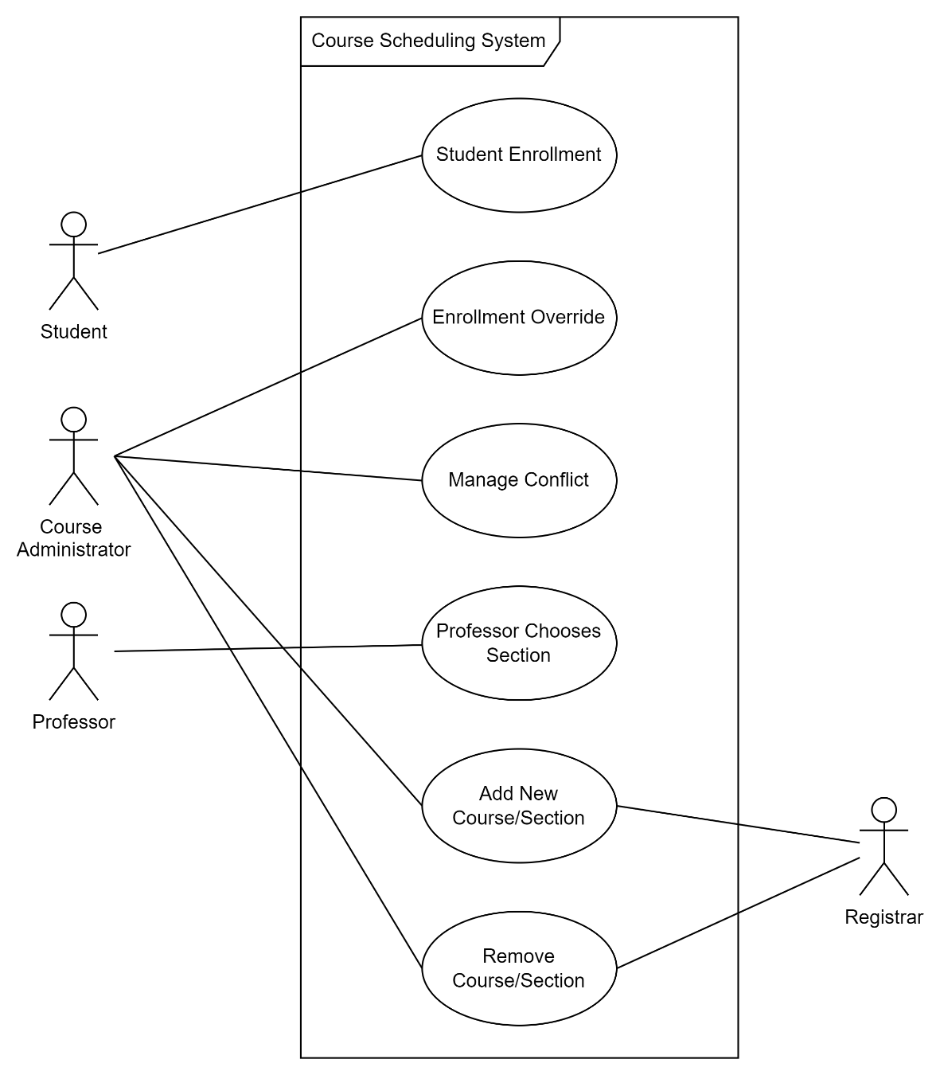
Use Cases
Notes:
The primary actors in the Course Scheduling System are Students, Professors, and Course Administrators. Students participate in the "Student Enrollment" use case. Professors participate in the "Professor Chooses Section" use case. Course Administrators participate in the "Enrollment Override," "Manage Conflict," "Add New Course/Section," and "Remove Course/Section" use cases. The secondary actor Registrar provides information for the "Add New Course/Section" and "Remove Course/Section" use cases.

Slide 10
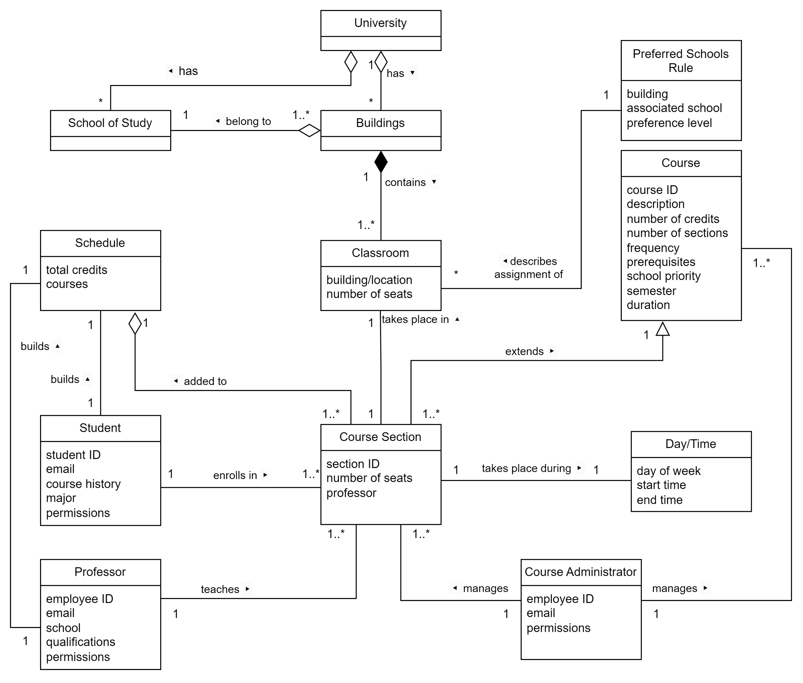
Domain Model
Notes:
The Domain Model begins at the University level. One University has many Buildings and Schools of Study. One to many Buildings belong to one School of Study. One Building contains one to many Classrooms, with attributes like building/location and number of seats. The Preferred Schools Rule has attributes like building, associated school, and preference level, and describes the assignment of Classrooms.
Course has attributes like course ID, description, number of credits, number of sections, frequency, prerequisites, school priority, semester, and duration. One Course is extended by one to many Course Sections. Course Section has attributes like section ID, number of seats, and professor, and takes place during a Day/Time (described by day of week, start time, and end time). Course Section is added to Schedule.
Student, with attributes like student ID, email, course history, major, and permissions, enrolls in one to many Course Sections. One Student builds one Schedule.
Professor, with attributes like employee ID, email, school, qualifications, and permissions, teaches one to many Course Sections. One Professor builds one Schedule.
Course Administrator, with attributes like employee ID, email, and permissions, manages one to many Courses and one to many Course Sections.

Slide 11
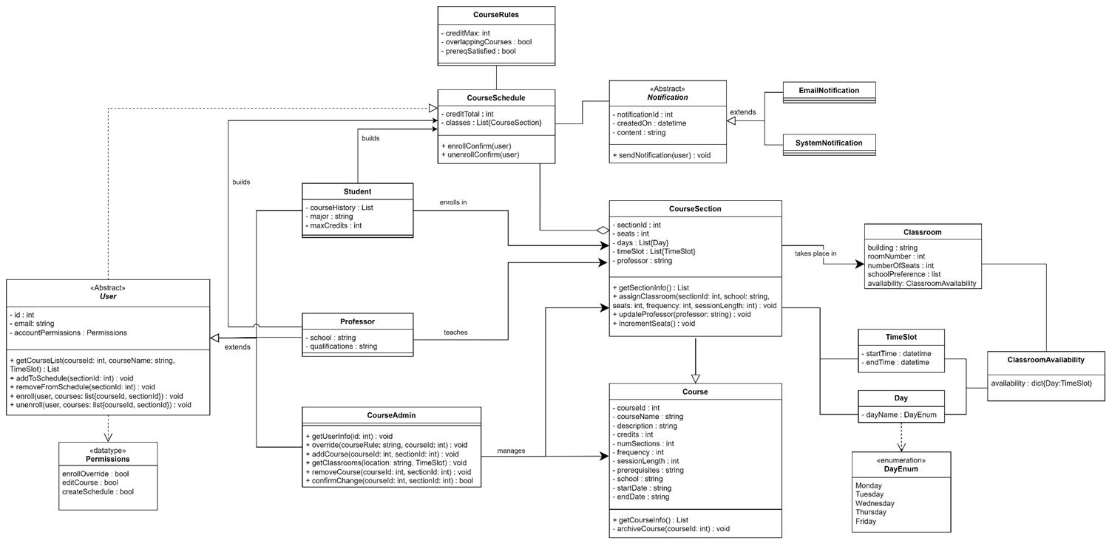
Class Diagram
Notes:
The Class Diagram is derived from and extends the Domain Model.
The Abstract User class generalizes the use classes, pulling out common attributes like ID, email, and account permissions. These account permissions have their own datatype of boolean expressions describing whether users can override enrollment, edit courses, or create schedules. In general, Student and Professor classes have the "Create Schedule" permission, while Course Administrators have the "Enroll Override" and "Edit Course" permissions. The User class has methods that allow users to search for courses, add and remove courses from schedules, and enroll and unenroll in courses. Student extends User, with additional attributes like course history, major, and maximum number of credits. Professor extends User, with additional attributes like school and qualifications. Course Administrator extends User and has additional methods that allow the course admin to override enrollment (get user information, override), create new courses, remove courses, manage conflicts (get classrooms, as a search for an available location and time), and confirm all changes being made. The User class as a whole is dependent on Course Schedules.
Course has attributes like course ID, name, description, number of credits, number of sections, frequency of occurrence (how many sessions in a week), session length (the amount of time a session takes, e.g., 50 minutes), prerequisites, school (which school in the university the course is a part of), start date, and end date. Course has a public method to return all of its information and attributes, and a private method (archiveCourse) to send all its data to an archive database so that the information isn't lost completely, but also isn't able to be enrolled in.
Course Section extends Course, with additional attributes section ID, number of seats, days (days of the week the course section takes place on), time slot (a list of the times at which the course section takes place), and professor (that teaches the course section). Course Section inherits the getCourseInfo method, and has its own public methods getSectionInfo (returns section-specific information), assignClassroom (a course section assigns itself to a classroom upon creation), and updateProfessor (when a professor registers themself to teach a course section, it updates the course section's professor attribute). Course Sections take place in classrooms, given the classroom's availability.
Students and professors add course sections to their course schedules. Course Schedule has attributes describing the total number of credits and the list of classes it contains. Whenever there are changes to courses and course sections that are part of course schedules, an email and/or system notification is sent to affected users. Course Schedule is associated with Course Rules, which are used to evaluate the validity of the schedule.The classes TimeSlot and Day are used to describe course sections and classroom availabilities, and the dayName attribute uses an enumeration of days of the week that courses can take place on.

Slide 12
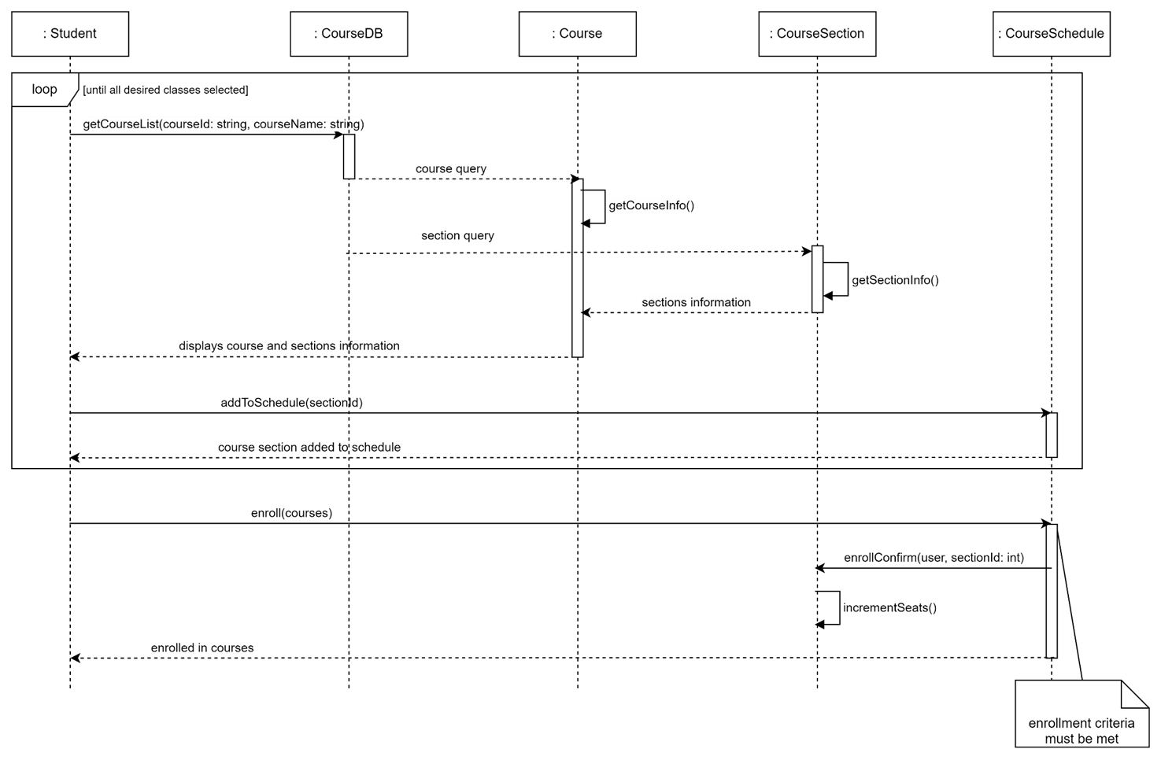
Student Enrollment
Notes:
The student searches for a course, invoking getCourseList to the Course Database, which gets the course info and section info and displays the information to the student. The student adds a selected course to their schedule, and this process repeats until the student has selected all the courses they want. The student enrolls in the classes in their schedule, and if all of the enrollment criteria are met, the course schedule confirms enrollment of the student, invoking incrementSeats on the course section and reducing the number of available seats.

Slide 13
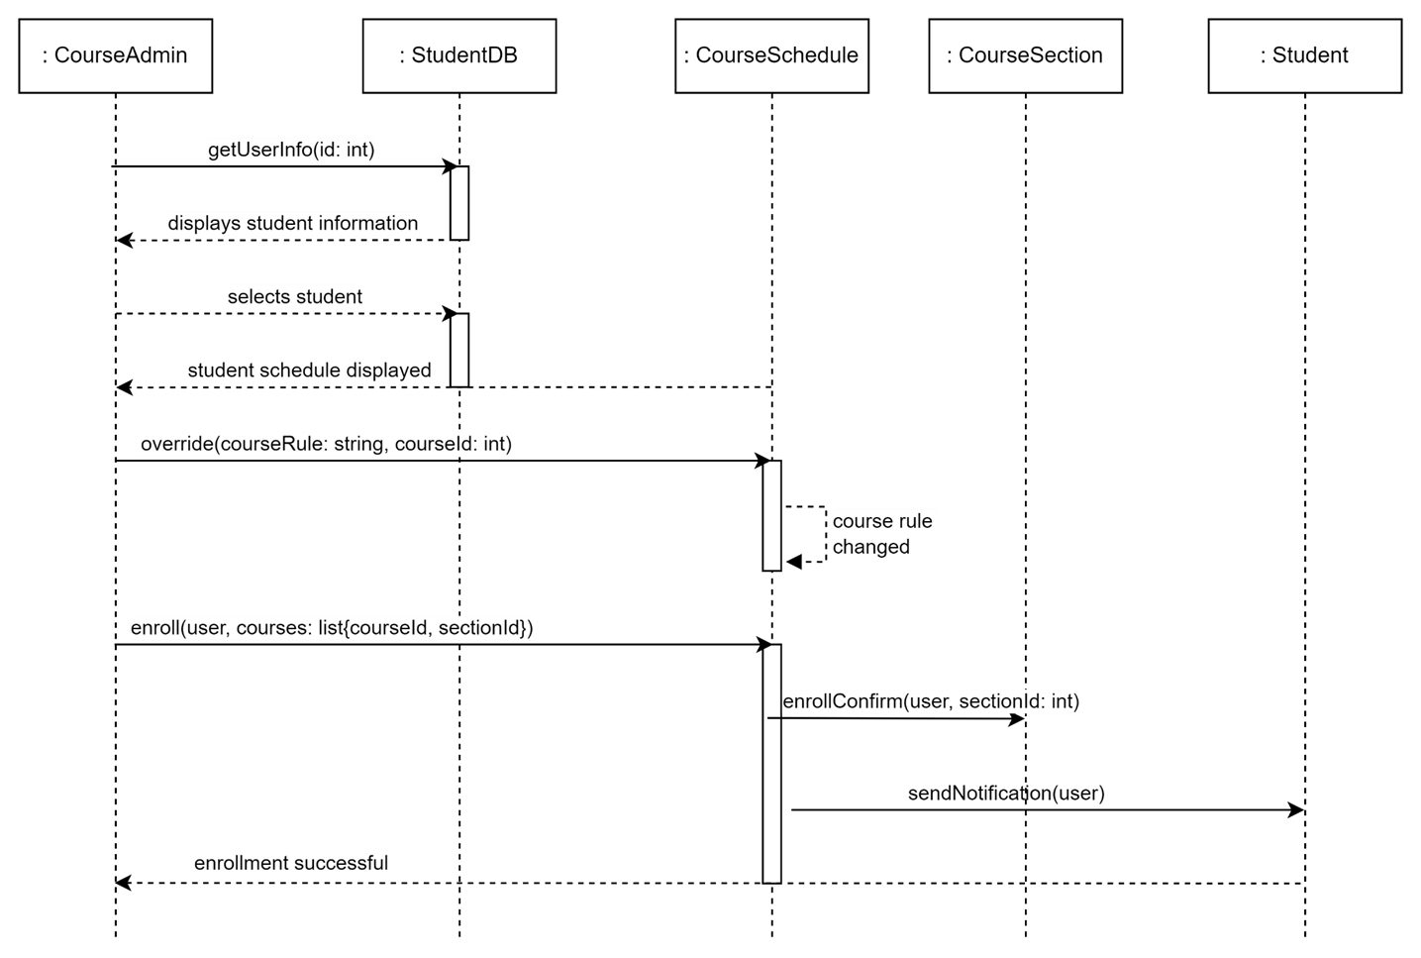
Enrollment Override
Notes:
The course administrator searches for student information in the student database, and selects a student. The student's course schedule, from the course schedule object through the student database, is displayed to the course administrator. The course administrator overrides the course rule, changing the rule in question. The course admin then enrolls the student in the course and the schedule confirms enrollment of the student, invoking incrementSeats on the course section and reducing the number of available seats. The course schedule notifies the student of the change.

Slide 14
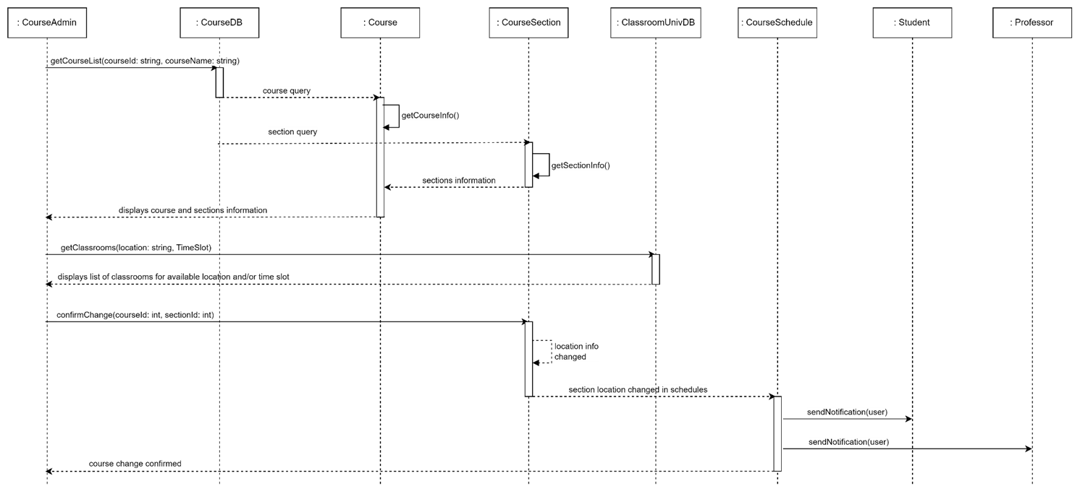
Manage Conflict
Notes:
The course administrator searches for a course, invoking getCourseList to the Course Database, which gets the course info and section info and displays the information to the course administrator. Separately, the course administrator searches for classrooms through the Classroom University Database to find an available location and time for the course section. The course admin makes the changes to the location and or time of the course section, and the section information is changed in any affected course schedules. The students and professors with the changed course section in their schedules are notified of the change.

Slide 15
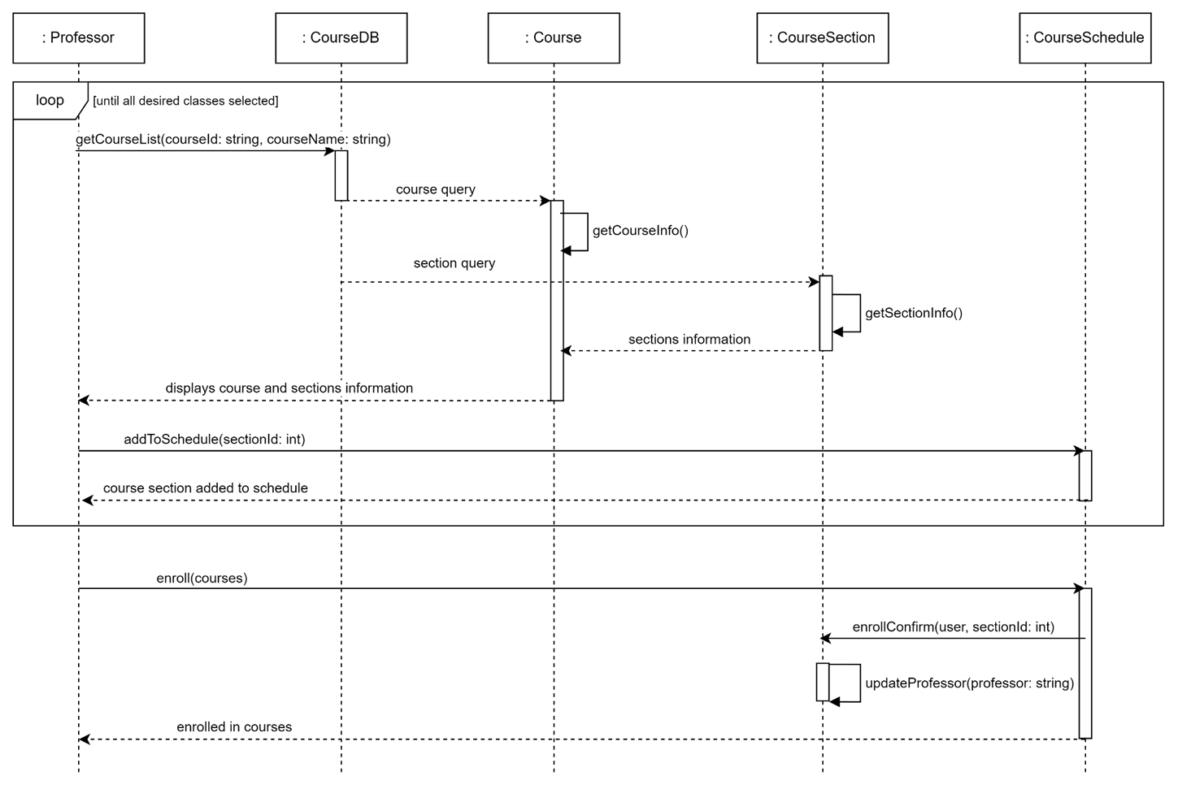
Professor Chooses Section
Notes:
The professor searches for a course, invoking getCourseList to the Course Database, which gets the course info and section info and displays the information to the professor. The professor adds a selected course to their schedule, and this process repeats until the student has selected all the courses they want. The professor enrolls in the classes in their schedule, and if no course sections overlap in their occurrence, the course schedule confirms enrollment of the professor, invoking updateProfessor on the course section and updating the course section's professor attribute.

Slide 16
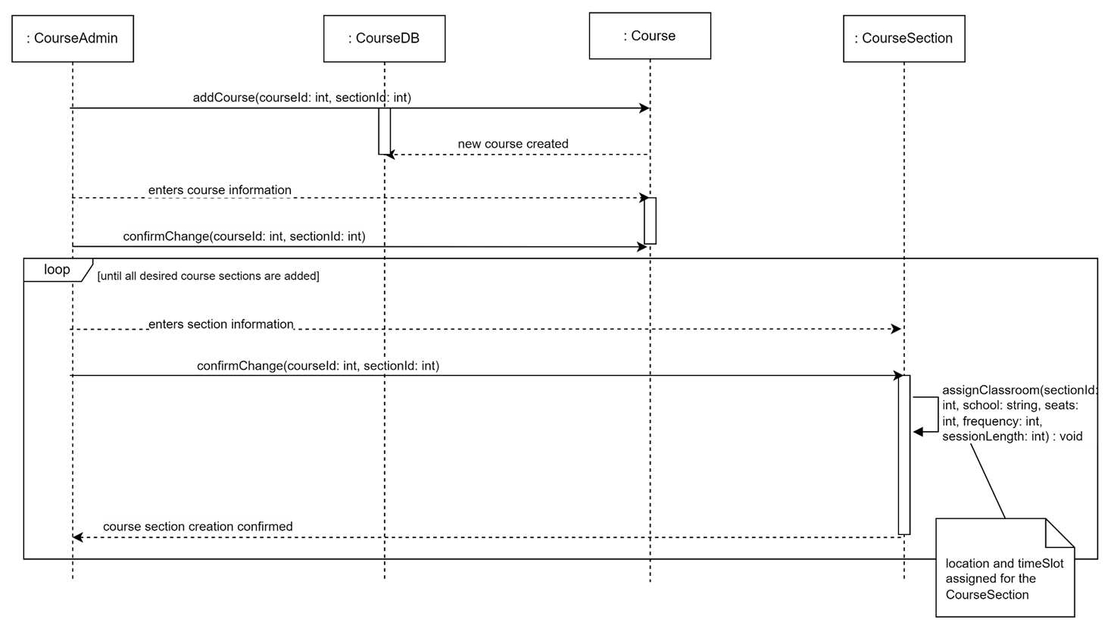
Add New Course/Section
Notes:
The course administrator invokes addCourse to create a new course object. The course admin enters course information and confirms those changes. The professor enters course section information and confirms those changes. The course section assigns itself to a classroom, and a location and time slot is assigned to the course section. This course section process repeats until all course sections are added.

Slide 17
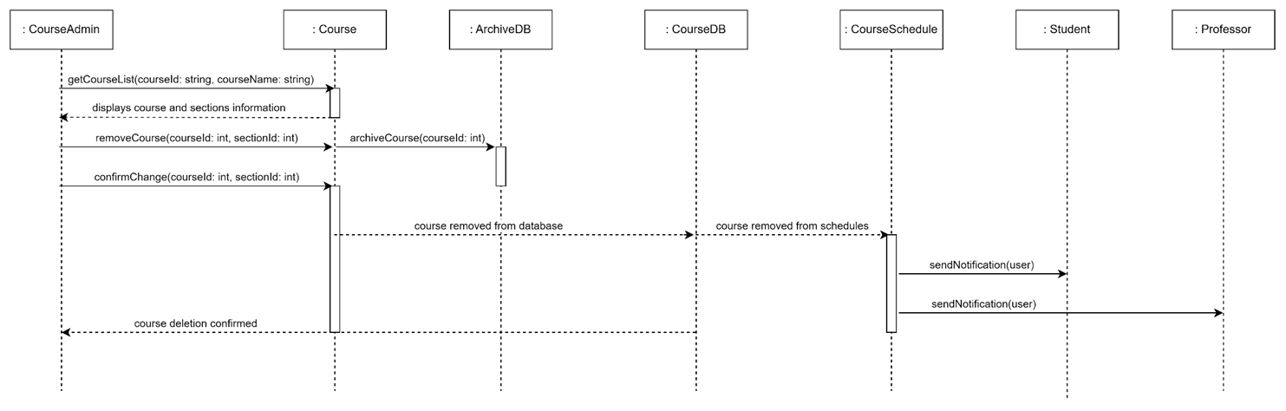
Remove Course/Section
Notes:
The course administrator searches for a course, invoking getCourseList to the Course Database, which gets the course info and section info and displays the information to the course administrator. The course administrator invokes removeCourse, and the Course invokes archiveCourse to send the course data to the Archive database. The course admin confirms the removal of the course. The course is then removed from the course database and from course schedules. Course Schedule sends notifications of the course removal to any affected students and professors. The deletion of the course is confirmed to the admin.

Slide 18
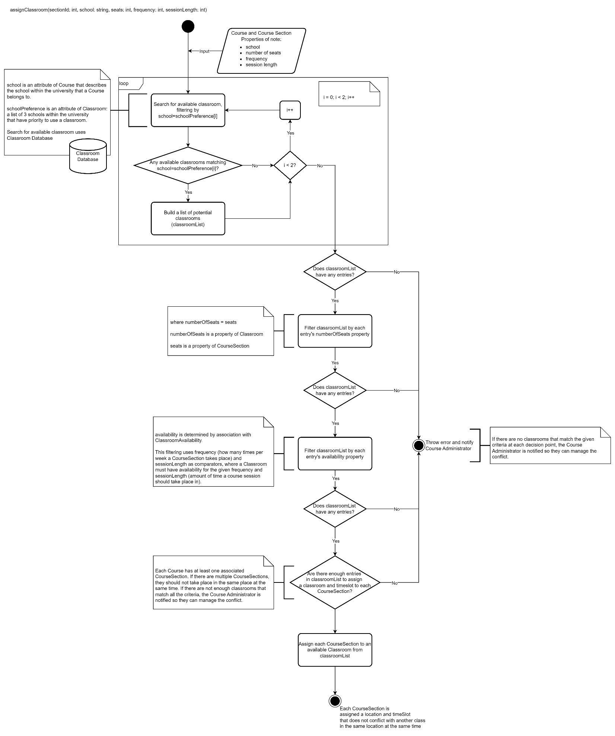
Activity Diagram: Assign Classroom
Notes:
The activity diagram shows how the assignClassroom method works.
There is an input to the method of the course section's school, number of seats, frequency, and session length. The system searches for an available classroom utilizing the classroom database, filtering by the course section's school matching the classroom's school preference. A classroom has a list of 3 schools within the university that have priority to use a classroom (schoolPriority). The system checks whether any available classrooms' school preference match the school, and if so the classroom is added to a list of potential classrooms. If not, the system checks the iteration of the loop and iterates if i<2. If the classroom is added to a list of potential classrooms, the system checks the iteration (i<2?) and either iterates (i<2) or moves to the next decision point (i>=2). This loop occurs three times, one for each index of schoolPreference.
At each step hereafter, the system checks if the list of classrooms has any entries, and applies another filter to the list. If at any point the list of potential classrooms doesn't have any entries, the system throws an error and notifies the course administrator so they can manage the conflict.
First, the system filters the list of classrooms by the number of seats, where the number of seats in a classroom must be greater than or equal to the number of seats in the course section. Then, the system filters by the availability of the classroom. This filtering uses frequency (how many times per week a CourseSection takes place) and sessionLength as comparators, where a Classroom must have availability for the given frequency and sessionLength (amount of time a course session should take place in.
Finally, the system checks to see if there are enough classrooms in the list to assign a classroom and time slot to each course section. If all steps are successful, each course section is assigned a classroom (location and time slot) that doesn't conflict with another class in the same location at the same time.

Slide 19
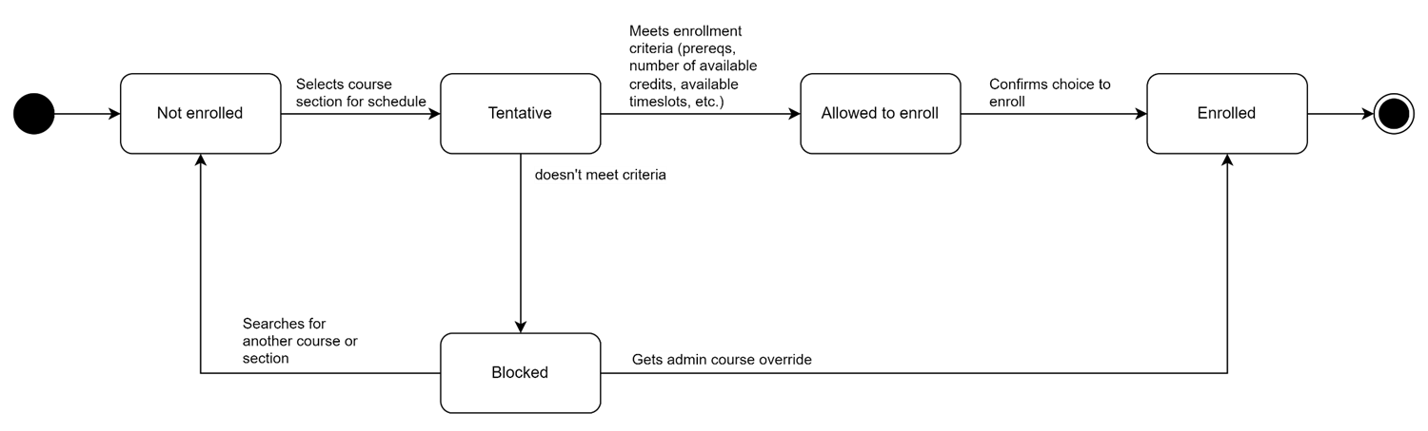
State Diagram: Student Object
Notes:
The state diagram shows the potential states of a Student object.
The Student begins as "Not enrolled." When a course is selected for the schedule, the Student is "Tentative" (tentatively enrolled). The system checks if the Student meets the enrollment criteria. If the student meets the criteria, Student is "Allowed to Enroll," but if the criteria are not met the student is "Blocked." From "Blocked" a student can search for another course or section and become "Not enrolled," or the student can get an administrator override and become "Enrolled." From "Allowed to Enroll," the student confirms their choice to enroll in courses and becomes "Enrolled," and the state machine ends.

Slide 20
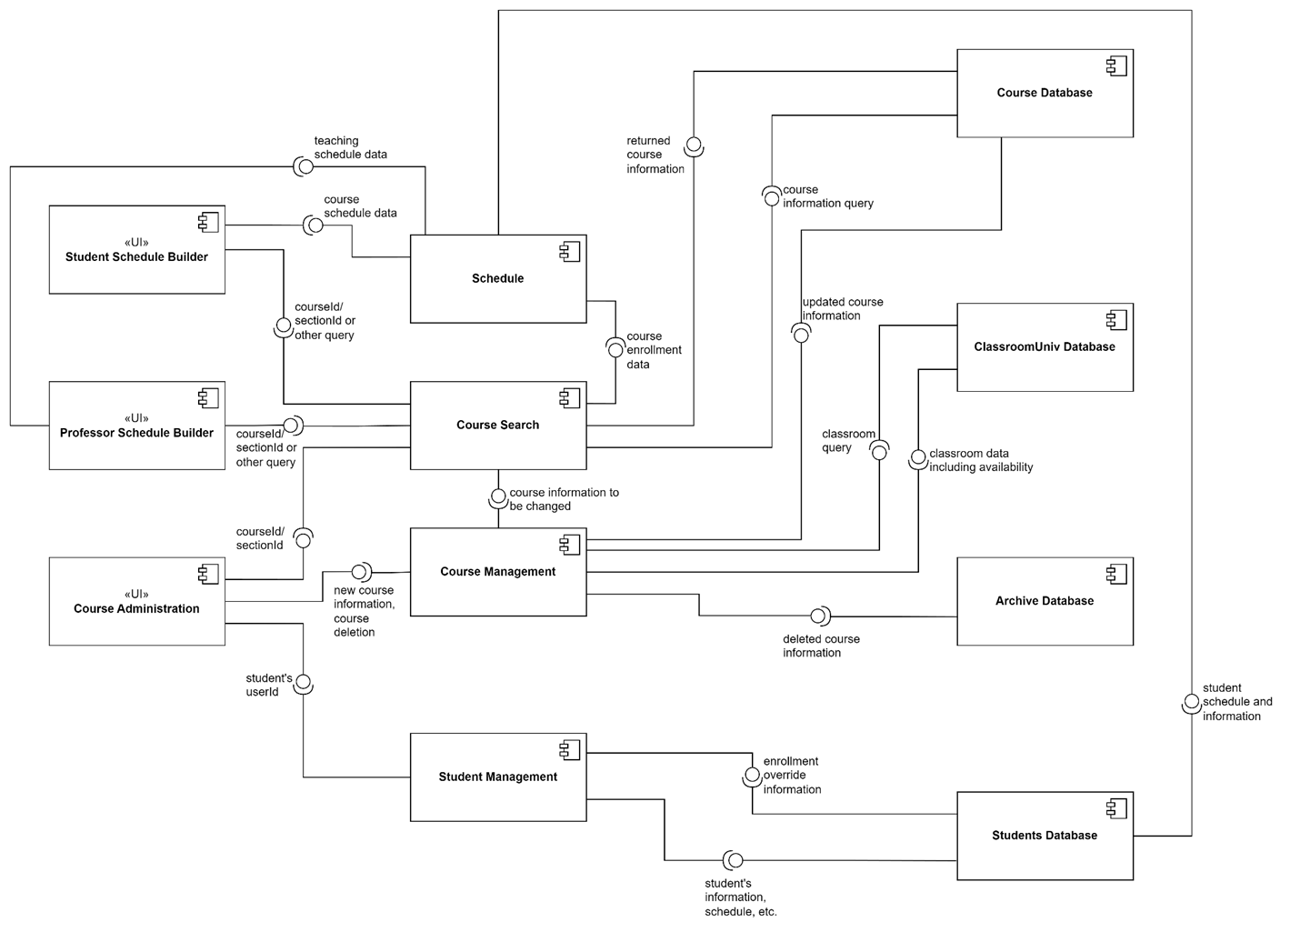
Component Diagram
Notes:
The component diagram shows the data flow and requirements between user interfaces for each user type, major components, and information stores (database).
The Course Search component is utilized in nearly all use cases and has data exchanges with all user types. The Course Search component utilizes the Course Database and provides course information to the Schedule component.
The Student Schedule Builder and Professor Schedule Builder UIs utilize the Course Search component and Schedule component to search for courses and build their schedules.
The Course Administration UI utilizes the Course Search component, which provides course information to the Course Management module, e.g., to manage location conflicts. The Course Administration UI also utilizes the Course Management component to add new courses or delete courses. The Course Management component requests and provides classroom data to the ClassroomUniv Database, provides updated course information to the Course Database, and provides deleted course information to the Archive Database.
The Course Administration UI utilizes the Student Management Component to override enrollment information for students and enroll them in courses. The Student Management Component interfaces with the Students Database, which in turn interfaces with the Schedule component for the student's schedule.

Slide 21
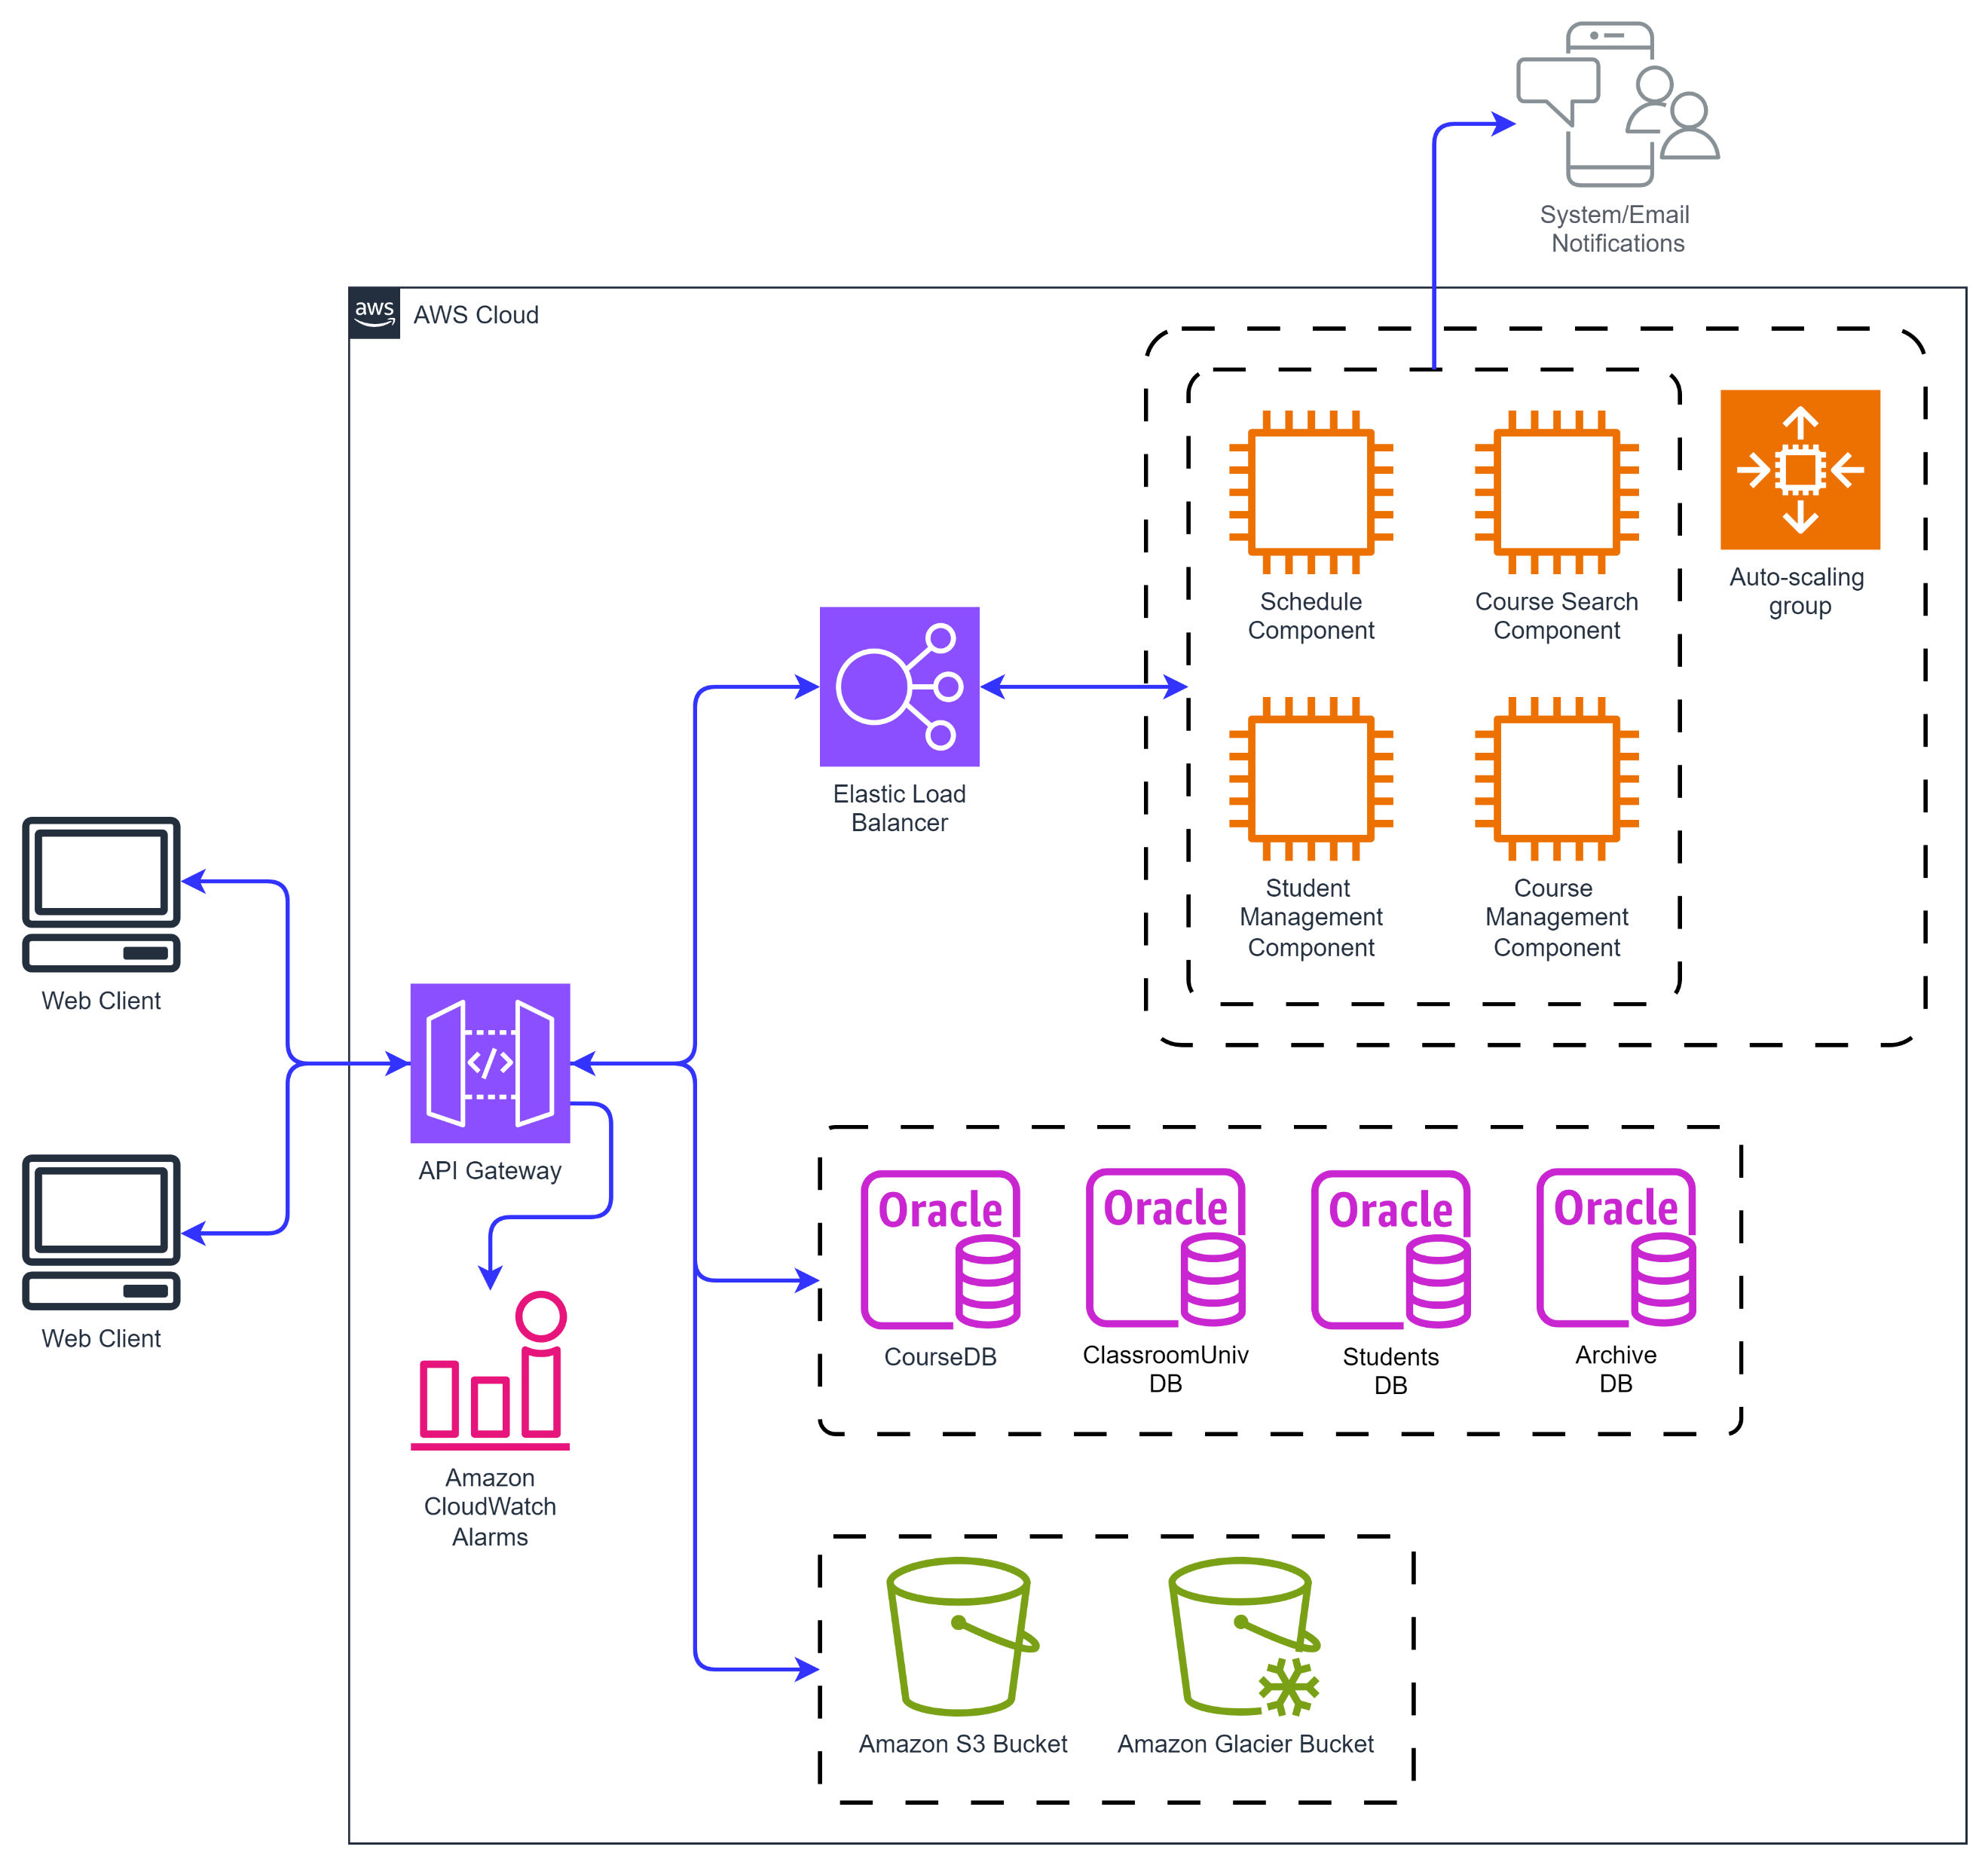
Deployment Diagram
Notes:
Deployment of the Course Scheduling System is pictured here using AWS. An API gateway acts as a single point of access for students, professors, and course administrators to access the system. The API gateway enforces access control policies so that, for example, a student can’t access the course management component, but only the schedule and course search components. The API gateway also partners with amazon cloudwatch alarms to inform university system administrators of issues.
The system utilizes elastic load balancers to manage traffic to instances of virtual machines that contain the scheduling component, course search component, student management component, and course management component. Those components, as part of the system design, send system and/or email notifications to users when changes are made to their schedules.
The system utilizes oracle as its database provider.
The system also uses an S3 bucket for long term storage of data for the classroom, students, and course databases, while the archive database would use the glacier bucket, as its resources would not be accessed as frequently.

Slide 22
Design Patterns
GRASP
Expert
High Cohesion
Cloud-Native
API Gateway
Notes:
The main design patterns used in this system are the GRASP Principles Expert and High Cohesion.
Assignment of methods to classes was based on Expert, especially as the system was refined. The assignClassroom method was initially part of the Course class, but when considering the fact that some of the inputs and the overall output of the function were specific to the CourseSection class, which extends Course, assignClassroom was moved to the CourseSection class.
In addition, the user classes (User, extended by Student, Professor, and CourseAdministrator) are an example of high cohesion in the system. Each class has its set of characteristics and abilities, and no more than is necessary. The goal is to limit the functionalities afforded to lower-privilege classes like Student and Professor, so that the ability to manipulate course data and override enrollment rules lies only with Course Administrators.
To incorporate cloud-native patterns I chose to utilize an API gateway in the AWS deployment structure. This gateway enforces access control and authorization policies to ensure that each user type is only able to perform the functions of their respective role. The gateway also serves to manage and monitor traffic from system users.

Slide 23
Conclusion

Slide 24
Conclusion and Next Steps
Gained valuable experience designing an object-oriented software system and building software system design skills
Next Steps
Refine dependencies between components
Introduce more GoF Patterns
Turn this exercise into a full-blown, portfolio-worthy software system
Notes:
In this project, I was able to outline an object-oriented software system from user identification and requirements definition all the way up to the point at which one would start writing code. This was a valuable exercise for me, as I don’t have extensive experience in designing software systems. I feel that this honed useful skills to designing any software system, especially in having the discipline to thoughtfully lay out a system rather than jumping straight into coding.
Next steps for this project would include refining the dependencies between classes to reduce coupling, and to consider adding GoF patterns where they may be of use. I did not focus on adding GoF patterns in this iteration of the project because I didn’t want to add patterns for the sake of adding patterns. I did not want to add patterns into the design without having a full understanding of what problems they would solve in the context of the Course Scheduling System.
I also designed the Course Scheduling System in a way that I could hopefully turn this exercise into a full-blown, portfolio-worthy software system.

Slide 25
Thank you!

